Slide 1


Library Data Archive
Providing archive and data services since 1961
November 20, 2017

Slide 2

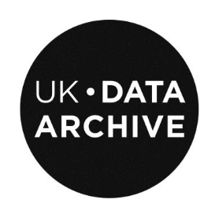
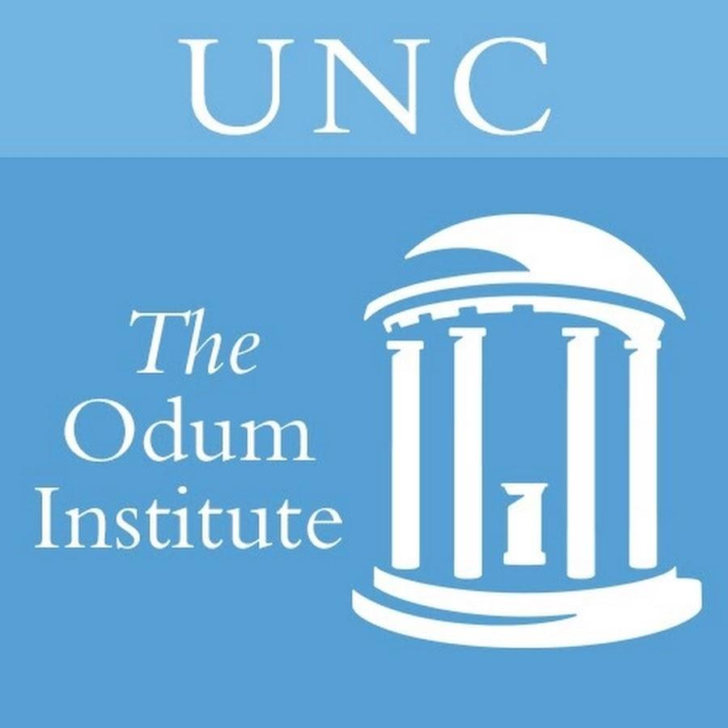

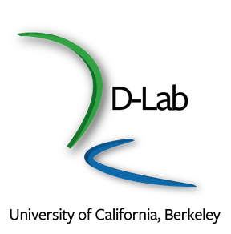


What is a Data Archive?
SSDA
Notes:
Origin of data libraries in the 60s have as much to do with centralized computing environments on campuses as social sciences developing as empirical research
Social Science Data libraries -- the poorer cousins of physical sciences -- came to data sharing and re-use of data as necessary for cost savings
Network of archives that shared data files between institutions spurred the need for data curation, documentation, stable files, etc. Much of our current understanding on how to manage data came out of these archives.
Cornell institute for Social and Economic Research
Inter-university consortium for social and political research
Roper Center for Public Opinion Research
Berkeley D-Lab - formerly UCDATA Archive
Yale= Institution for Social And POlicy studies

Slide 3
What do data archives typically do?
Data collection, management and preservation
Research support through the data lifecycle
Data and computing support
Instruction on, tools, methods, data management and analysis
Reflects empirical nature of social science research and the emergence of centralized computing and statistical computing
Notes:
If you look at what SSDA and our peers are doing this is a rough representation of what we do
Archive implies rigorous long-term preservation procedures (reuse and discovery)
Some see archives as long-term IT storage service aka long term backup (keeping bits safe)
The SSDA is more of an Archive in the rigorous long-term preservation sense of archives
Data Archives should worry about digital preservation concerns, such as, bit rot, format obsolescence, etc.

Slide 4
SSDA

Slide 5
Social Science Data Archive
Political Behavior Archive
Started by political science professor Dwaine Marvick. In 1962, became a founding member of the Inter-university Consortium for Political and Social Research. In 1964,. joined Survey Research Center under Eve Fielder
Joins the Library
Brought into the library to continue and amplify the operations and services of the Data Archive within the Digital Initiatives and Information Technology (DIIT).
1977
2018
1961
2014
Social Science Data Archive
Joined the Institute for Social Science Research (ISSR)
Creation of Data Science Center
Umbrella program to build data science support & data archiving across disciplines
Notes:
Started in 61 by polisci faculty, founding member of ICPSR in 62
Became part of ISSR - institute for socsci research - in 1977
ISSR -service unit supporting secondary analysis
2003, '09 SRC Closes, ISSR becomes Grant Support
The Archive continues as a solo unit as part of the Social Science Division
Acquired by the library in 2014 to continue services and broaden reach - idea is that data more interdisciplinary and we can serve more through the library,
Move being planned now

Slide 6
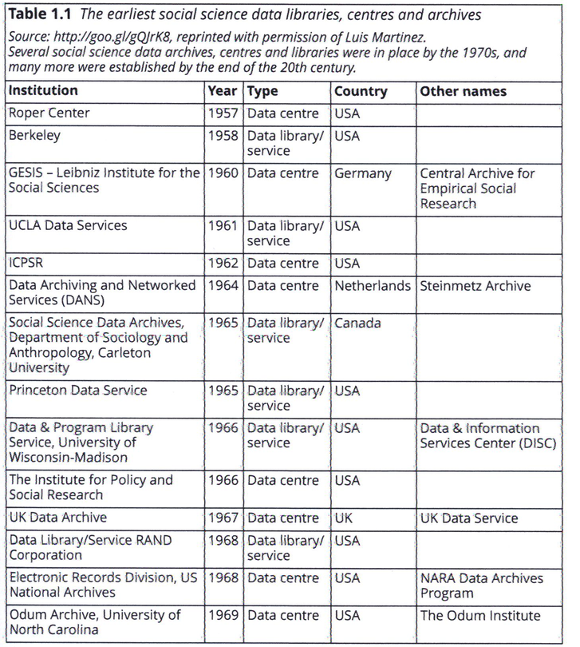

Slide 7
Role of the Data Archive in Soc. Sci. Div.
Supported social science research through all stages of a project, including:
  hypothesis or area of study development
  grant and funding activities
  data collection, analysis, management, and communication
  long term preservation of research data/results/artifacts

Slide 8
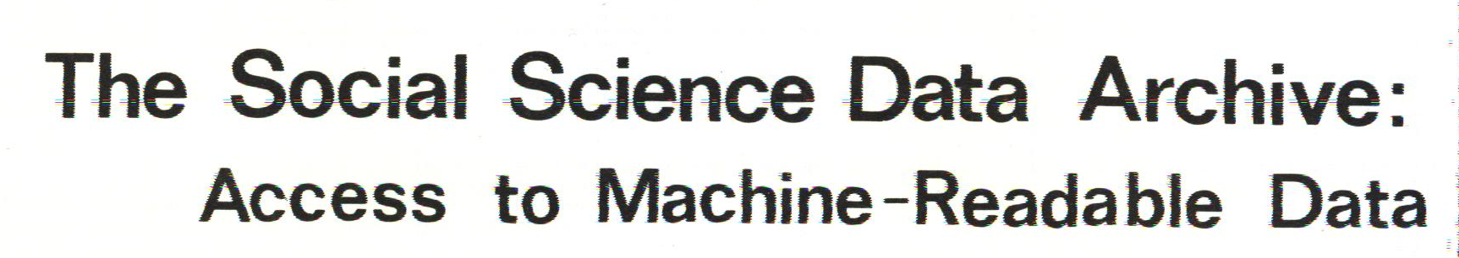
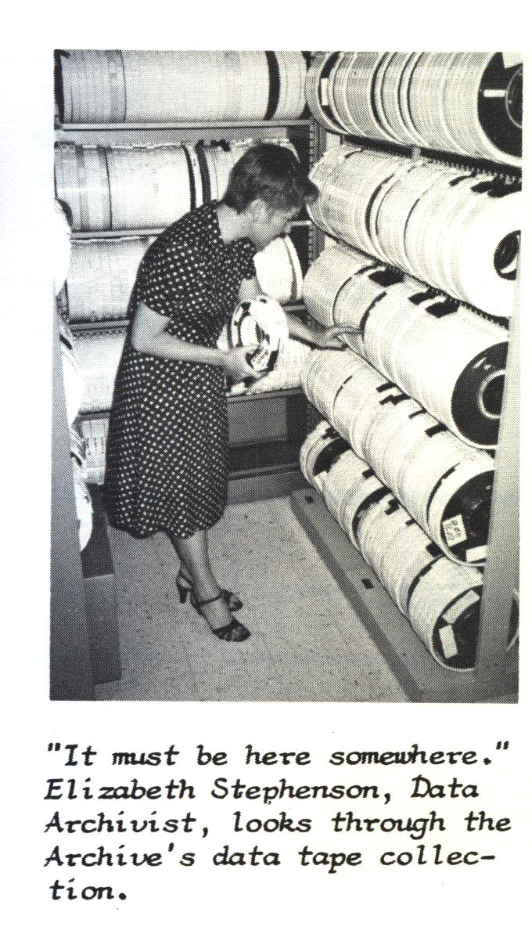
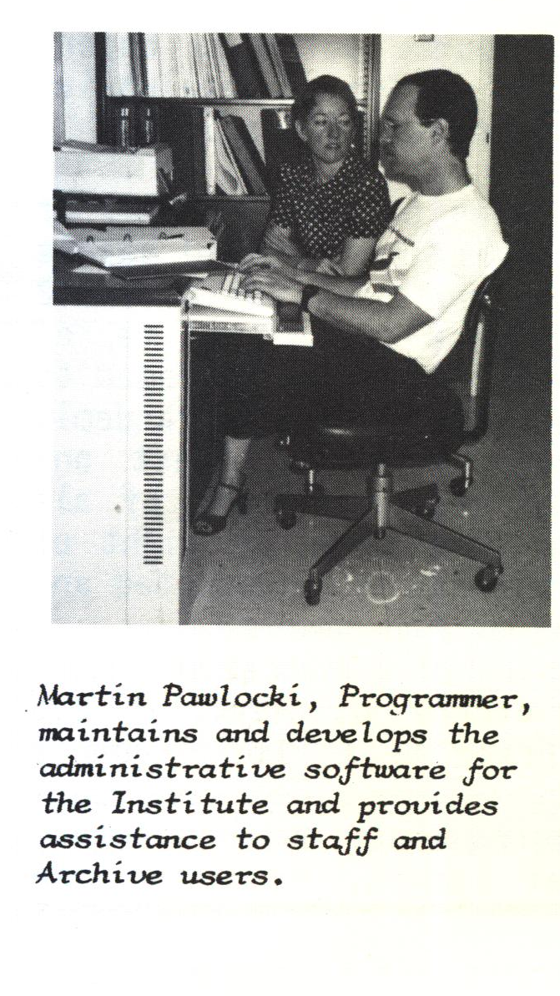
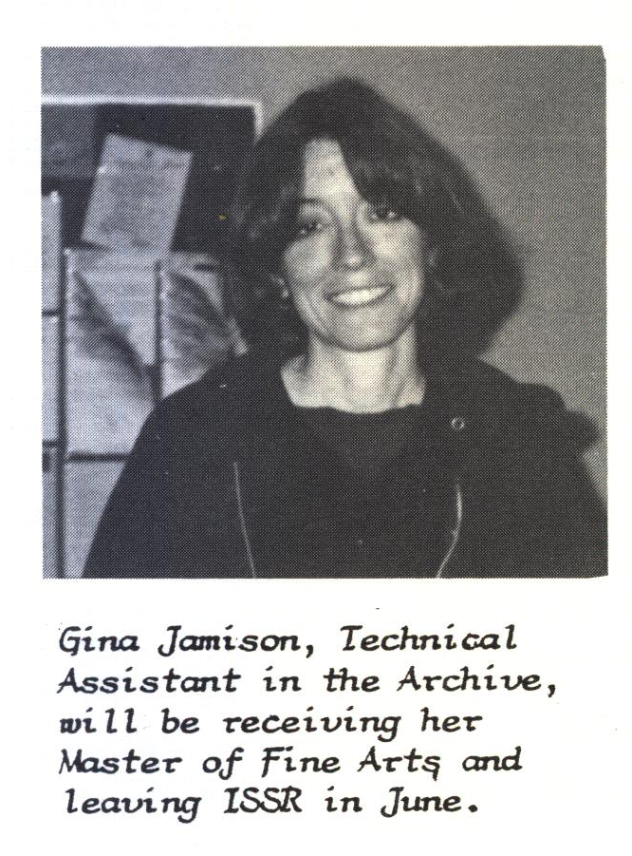
Notes:
Around 1985, tape reels is where data was stored -
both data deposited by UCLA researchers and from other data archives (ICPSR) and governmental agencies (Census, BLS)
Archive employed, technical data staff, statisticians, programmers
Mispelled name - that’s why I use my nickname, people always try to fix what thay think my name really is (Jina)

Slide 9
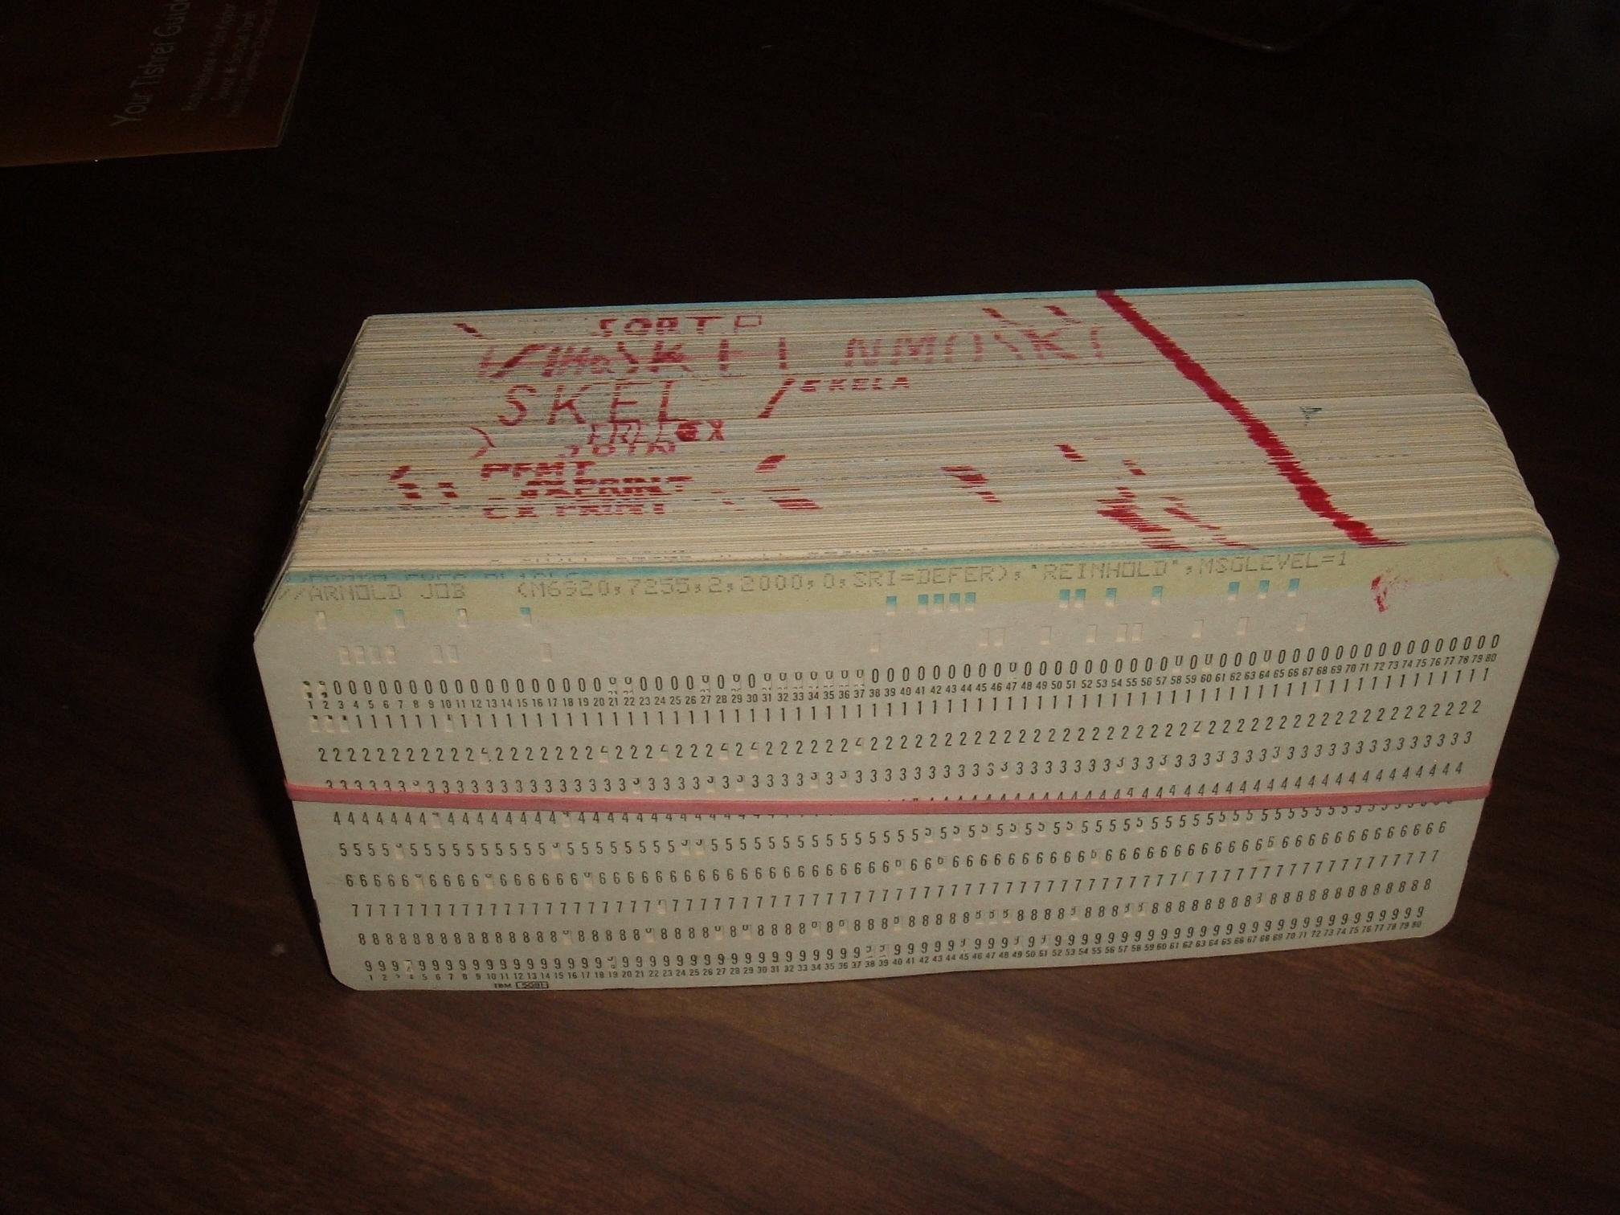
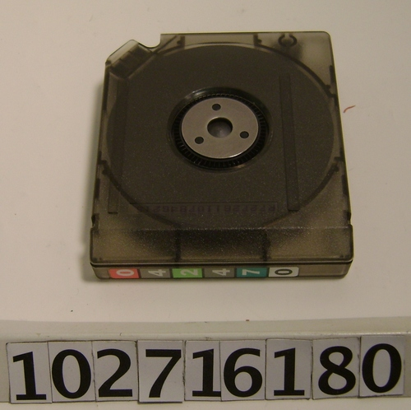
Notes:
Punch Card (early data analytic software)
Surveys were expensive to conduct -- led to setting up network for data sharing
Tape era, cartridges, jukeboxes
CD/DVD era, remember .bat files?
Many of the well known Stats packages have their origin in the mainframe era: SAS, SPSS, R (e.g. there’s a continuity between the eras)
Availability of data over the web obviated the need for sending around data, but the practices, support and experiences around data persist - technical data skills are irreplaceable in research

Slide 10
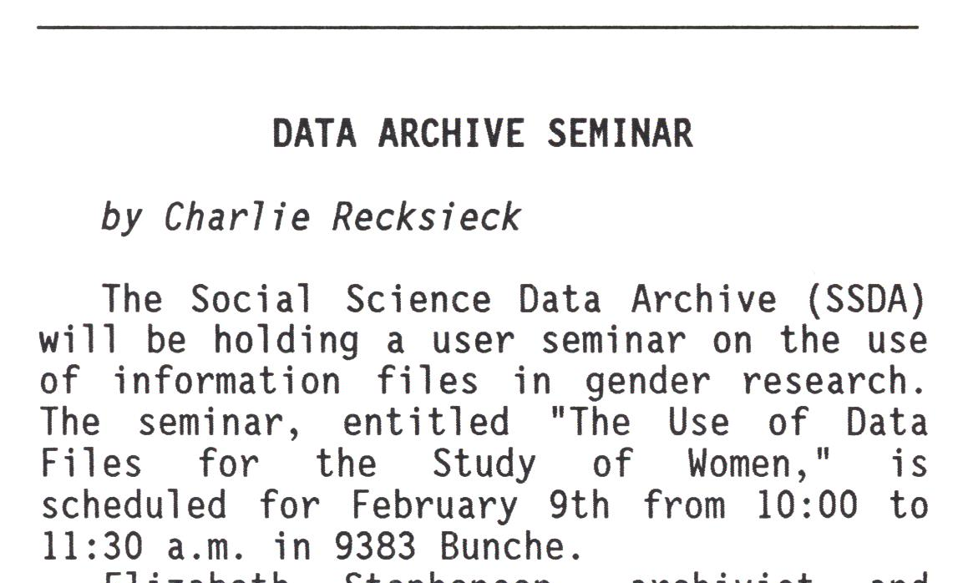
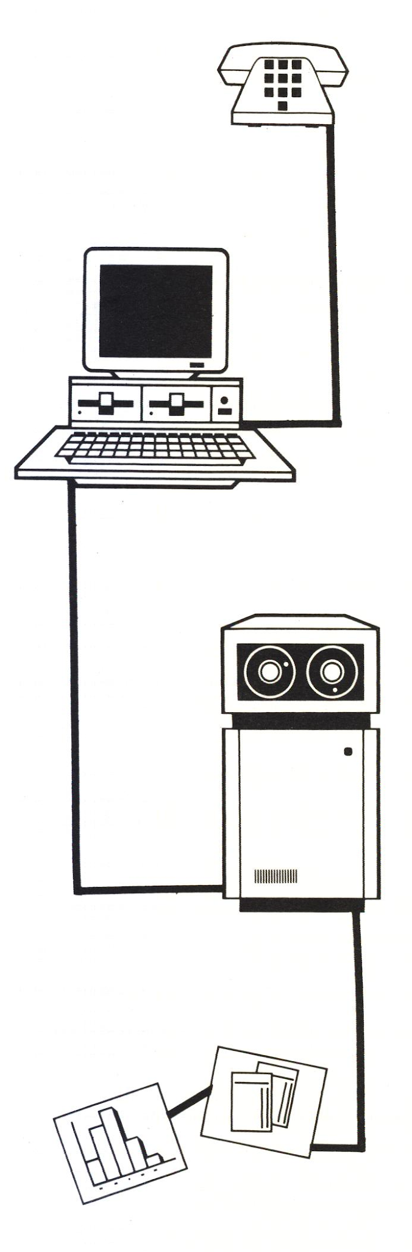
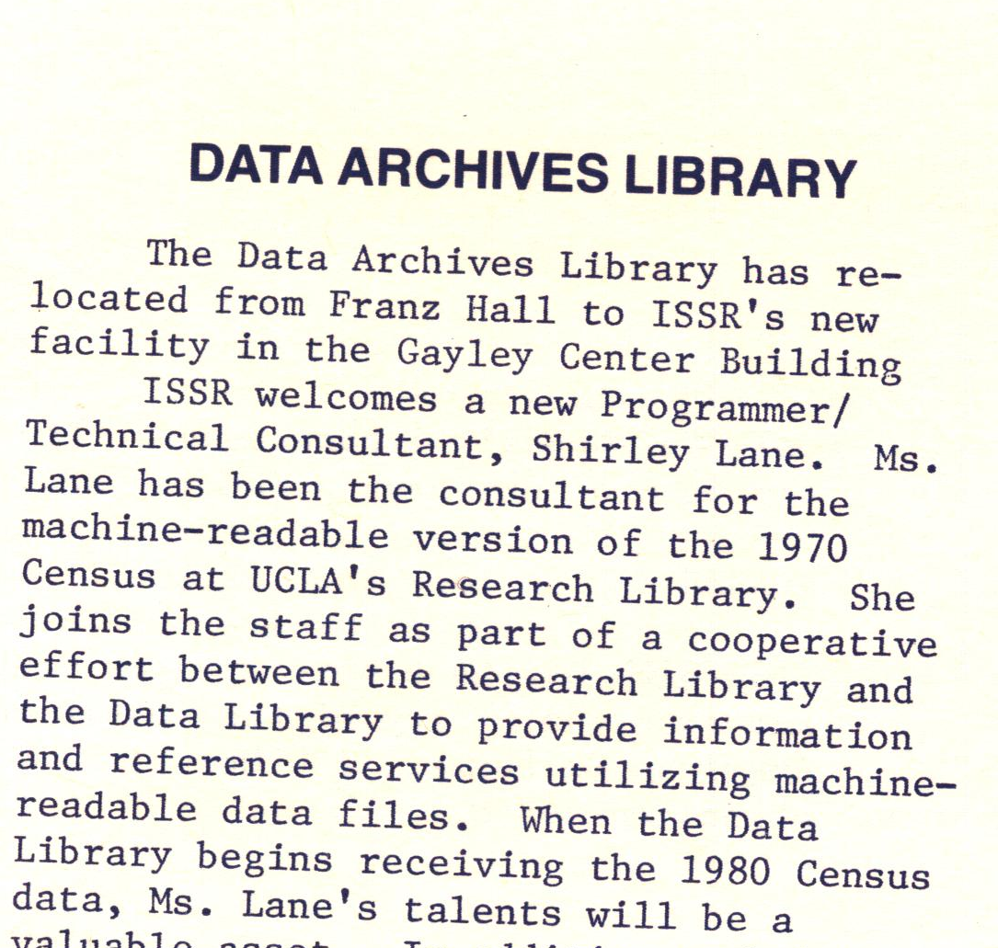
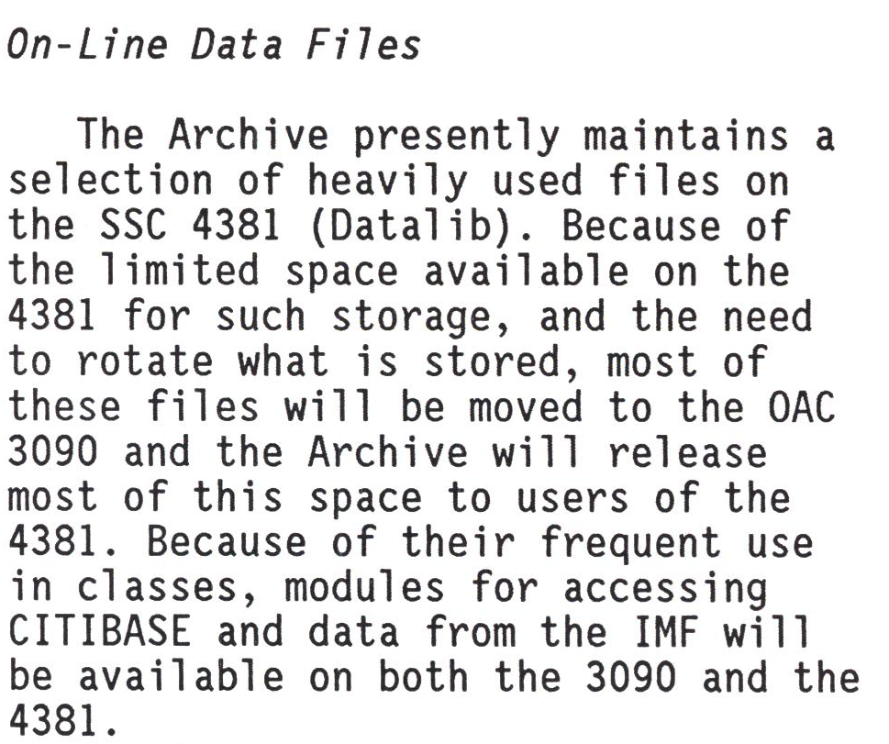
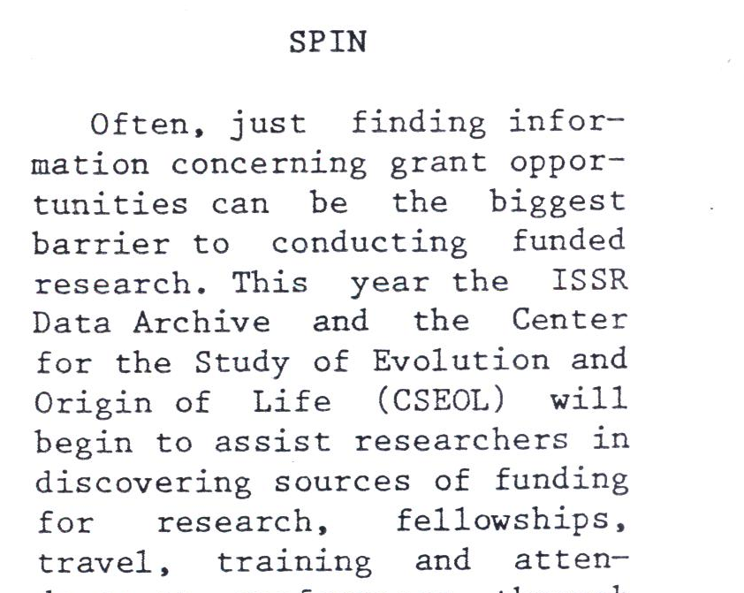
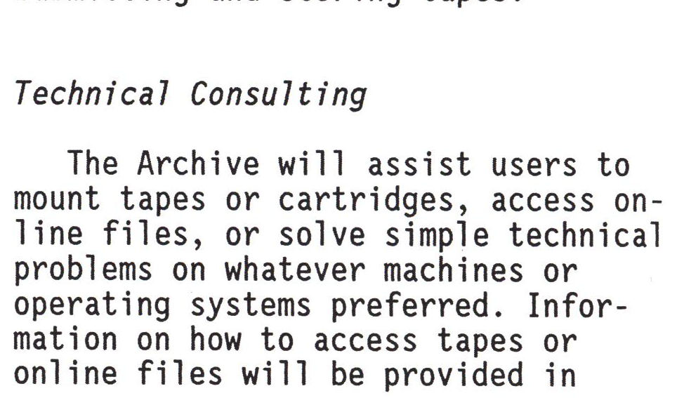
Notes:
Data Archives Library hired programmer /tech consultant with UCLA Research Library to provide information and research support for 1970 censu
Technical consultations
Data archive put on seminars in addition to course related instruction and stand alone classes on tools and data
Archive provide help with finding grants and project inception
“On-line” files and tapes were service via mainframe system
Ironically, once we moved to web, the archive activities are harder to recover, but Jamie indicates the continued instruction, consulting, and archive services
The Archive put up web accessible repository of their collections
The need to get tapes from Archives disappeared, but the data support around these continued

Slide 11
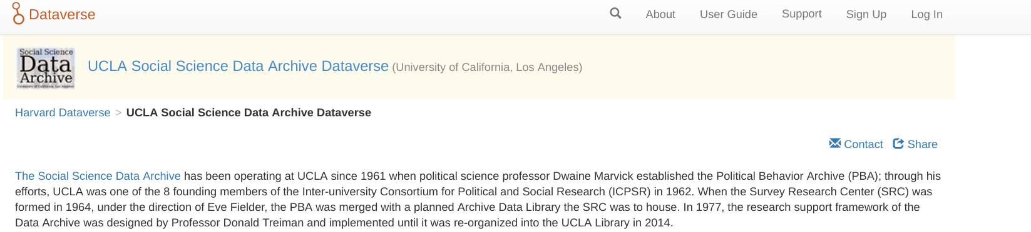
Collections
Approx. 600 datasets (some unpublished, ask us)
Mostly from surveys, public opinion polls, and de-identified administrative records.
Include studies on:
  Political, social & economic attitudes and behavior
  Studies of health status and health outcomes
  International surveys of occupational and social mobility
  Los Angeles County Social Surveys & California Polls
Notes:
These collections were curated for discovery and long-term reuse by Archive staff
By comparison ICPSR -the leader in soc sci data archiving and well staffed has approx. 9000 data sets

Slide 12
SSDA in the Library

Slide 13
Data is the central currency of science, but the nature of scientific data has changed dramatically with the rapid pace of technology. – Ted Hart (@emhart), et. al., Ten Simple Rules for Digital Data Storage.doi:10.1371/journal.pcbi.1005097
Access to the computational steps taken to process data and generate findings is as important as access to data themselves. – Victoria Stodden, Enhancing reproducibility for computational methods. Science 09 Dec 2016 : 1240-1241. 10.1126/science.aah6168
Notes:
REFLECTION POINT in transition
How do we align our services to support this transition?
Implied in this quote is the motivation for the discipline of data science (the author is a data scientist for Apple)
DS requires combinded skills in CS, stats and some ability to work with disciplinary data
These are critical skills for data-centric computationally intensive research.
How we create and understand data is critical to the precepts of good science - science at it's core needs to be repeatable
Transparency in research an overarching goal

Slide 14
The Data Archive will (continue to) provide research data services in three interrelated areas:
Consulting and data support;
Archive and repository services; &
Educational program.

Slide 15
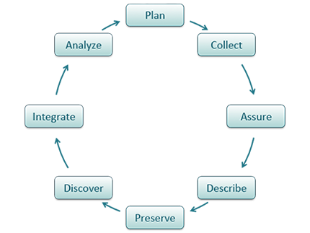
The Data Archive will continue to support all phases of the data lifecycle:
Notes:
Help researcher with project inception and research questions (in context of the data they have or will create)
Review data sources and help provide provenance documentation
Create/review data management plans
Help with filenames, standard terminology
Choosing stable file formats
Help identifying suitable repositories (including own DataDen)
Documenting data transformations, coding review & best practices
Support for analysis of data and replication of research claims
Provide data curation and stewardship of data for long term reuse and discovery

Slide 16
Also support research innovation
Machine learning
Network analysis
Text analysis
Cloud computing and storage
Web data and APIs
Data visualization
Programming service and code review
Notes:
This reflects the state of current research - social scientists are engaged in these methods
5 years ago Soc Sci were more concerned with quantitative research, but now it’s text as data
I took 2 week boot camps on ML while at UCSD to respond to this need
The archive should be the hub for advanced research technologies support in the library and partner with campus entities to provide a full spectrum support
This has a certain nice cycle - archives originated and were enabled by advances in centralized computing at academic and in statistical methods and computing - the data at scale and data science techniques are an extension
This is also a trend at other Archives (CISER provides HPC support, ODUM data science)

Slide 17
Archive and Repository Services
Continue archival services
Add data publishing & sharing
Data curation support
Data management best practices support and training
Data stewardship
Data Den and Dataverse repositories
Curating for reproducibility
Working with data at scale
Be responsive to interoperability needs (ORCIDs, APIs, Preregistration)
Notes:
We will continue to help researchers structure, describe and package their data for long term use
We will also provide technical infrastructure for sharing and publishing data
And will introduce important concepts like reproducible research (this makes the data better when they deposit)
Finally, we are engaged with the international data communities and standards developments and will help shape and advocate adoption
Open Researcher and Contributor ID - unique idea for a researcher, good for tying together researchers work

Slide 18
In a 2016 survey of 704 NSF Biological Sciences Directorate principle investigators… nearly 90% indicated they are currently or will soon be analyzing large data sets. …. the most pressing unmet needs are training in data integration, data management, and scaling analyses for HPC … This portends a growing data knowledge gap in biology and challenges institutions and funding agencies to redouble their support for computational training in biology.
Unmet Needs for Analyzing Biological Big Data: A Survey of 704 NSF Principal Investigators https://doi.org/10.1101/108555
Notes:
In report after report from the NSF about research and career development, the need for skills in software development and data science tops the list.

Slide 19
New knowledge and skills will be needed to make effective use of new system architectures and software. “Hybrid” disciplines such as computational science and data science and interdisciplinary teams may come to play an increasingly important role. Keeping abreast of a rapidly evolving suite of relevant technologies is challenging for many computer science programs ...
Future Directions for NSF Advanced Computing Infrastructure to Support U.S. Science and Engineering in 2017-2020: Interim Report
Notes:
In report after report from the NSF about research and career development, the need for skills in software development and data science tops the list.
Training will be key ingredient for the data archive and how we help researchers and library professional gain skills so they can better engage with research.

Slide 20

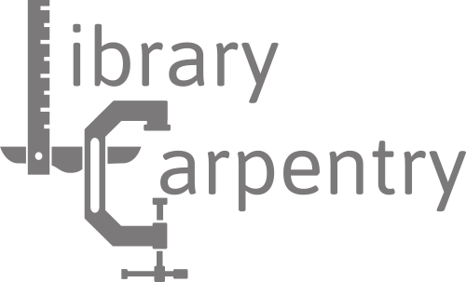
Notes:
The DATA archive will be the organizing entity for delivering Software & Data Carpentry workshops for the library,
We aim to have on of each bootcamp workshop (SW, DC and LC per quarter)
We will need help delivering these, so if interested contact us
If you aren’t familar with the carpentries:
SWC - Software development best practices (Domain agnostic) - Code modularity, problem decomposition skills, and DRY concepts (writing functions)
DC - Working effectively with data includes domain-specific content, data organization/management, data lit, data analysis, project based skills
LC - a bit of both, computational basics, benefits of automation, data 101 -- getting librarians ready to support and then teach researchers on best practices in data and software
These are all based on a community of practice model (situated learning) - peer focused - where lessons are collaboratively authored and maintained
There’s a global volunteer network of instructors trained in research based pedagogical practices
I’m hoping the carpentries are a way that librarians can develop their skills, become involved with the data archive and help teach other librarians and researchers.

Slide 21
Other topics for instruction
Concepts of reproducible research
  Application of concepts in a tool (R, Stata, Python or Open Science)
Data publishing
Data cleaning topics in OpenRefine and R
Text mining in R
Data visualization
Research project management, package/dependency management and capturing compute environments
HPC and cloud computing

Slide 22
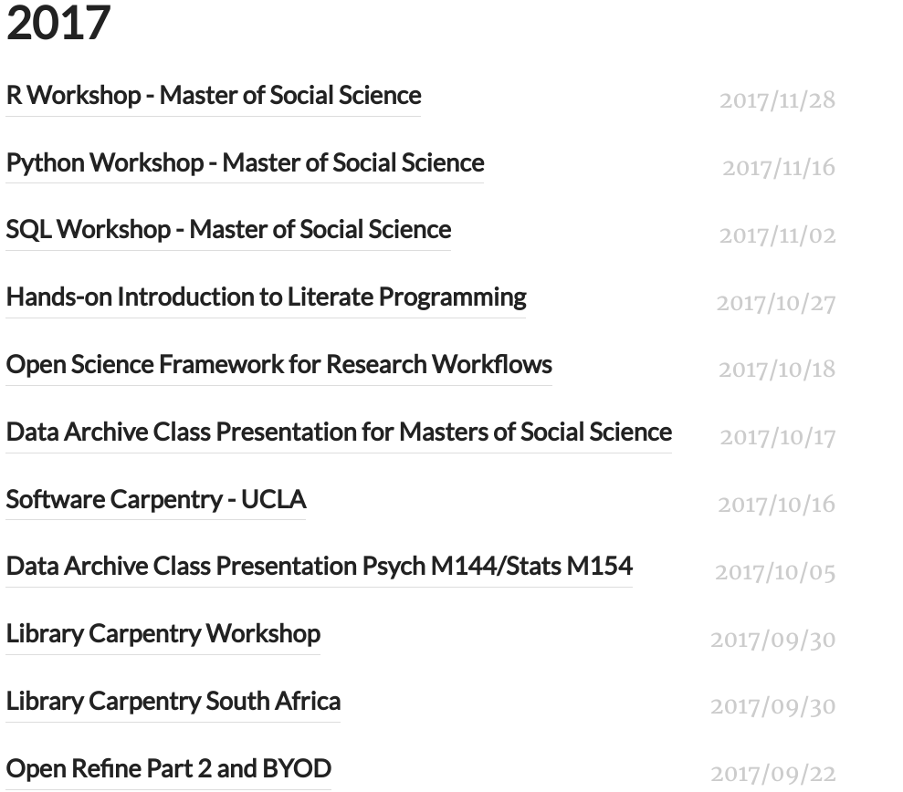
Fall Quarter Offerings
Notes:
Current quarter gives a sense of where we are headed:
One off R, python and other tech course
We like working with departmental needs (something the ARchive has always done), but will offer open courses in these topics
We will bring in experts to teach workshops like the Open Science Framework
And offer bootcamp carpentries
We will also provide instruction designed for librarians (library carpentry) and data management workshops like 23RD Things
The desire is to help librarians become more data and code savvy

Slide 23
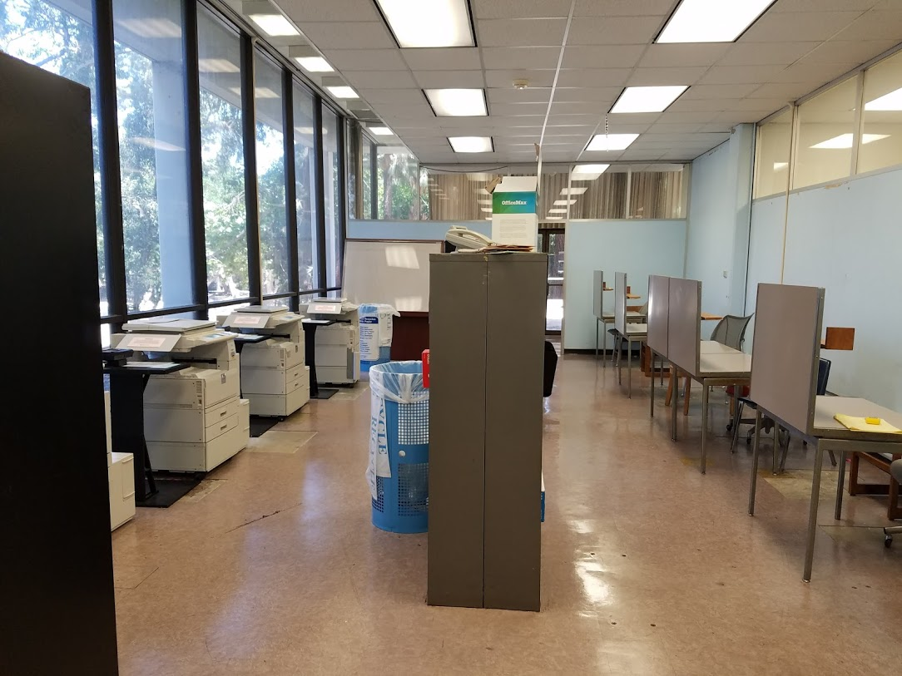

Slide 24
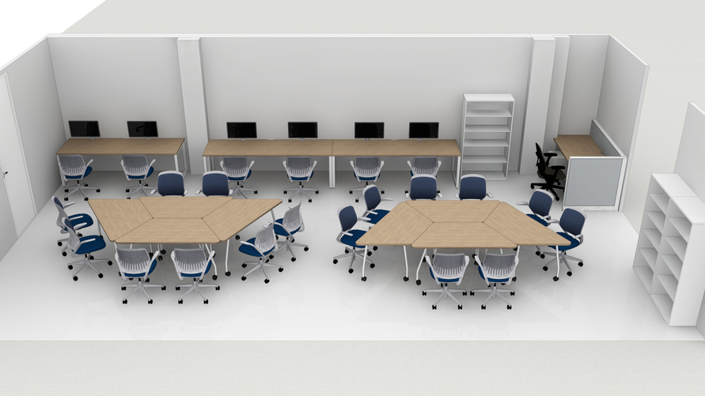

Slide 25
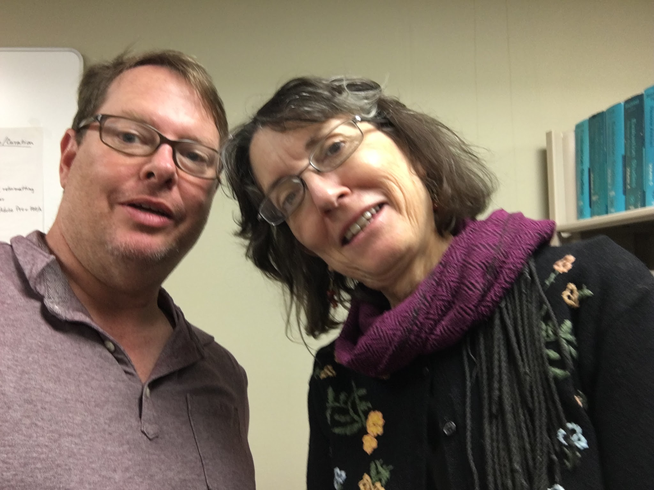
Thank You
ucla-data-archive@googlegroups.com
‹#›

